Slide 1
Sulamot Project
Final Presentation
github: https://github.com/TechnionTDK/jbs-mekorot-android

Slide 2
“Sulamot” App For The Jewish Bookshelf
An Android application providing accessibility to the texts of the jewish book shelf with various options that function as a search engine for texts (mekorot) within the Jewish Bookshelf.
The current project is a continuation to an existing project.
A presentation about the work that was done until the starting point of this project can be found at:
https://github.com/TechnionTDK/jbs-mekorot-android/blob/master/jbs-mekorot-android.pptx

Slide 3
“Sulamot” App For The Jewish Bookshelf
Accessing the jewish book shelf via a linked data set built on top on RDF using SPARQL.
The jewish book shelf linked data sets consists of the following:
Defining a JBS ontology (classes and properties)
Representing the structure of various Jewish texts in RDF format, based on the defined ontology
Conducting text analysis tasks, and representing the results in RDF

Slide 4
Project Main Features
Error reporting feature
Results caching
Extended search mode
Android application structural modifications

Slide 5
Error Reporting - Overview
The underlying database which serves the application is automatically generated by a computer, therefore it is bound to have some errors.
Adding crowd-source error reporting feature to the application provides zero-effort error log that can help improving the database accuracy.

Slide 6







Error Reporting Architecture
Ubuntu Server
Sulamot App
Volley POST request
local MySQL DB
php interface
Admin
Web Interface

Slide 7
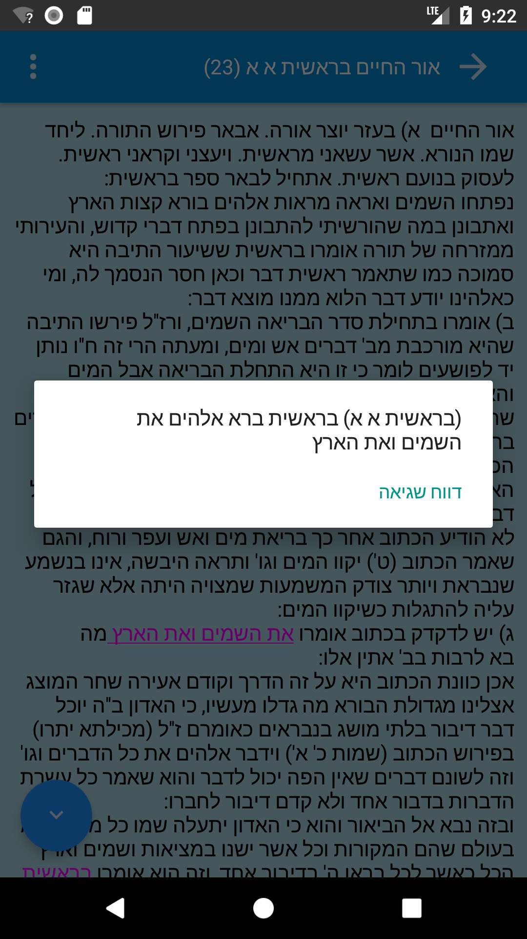
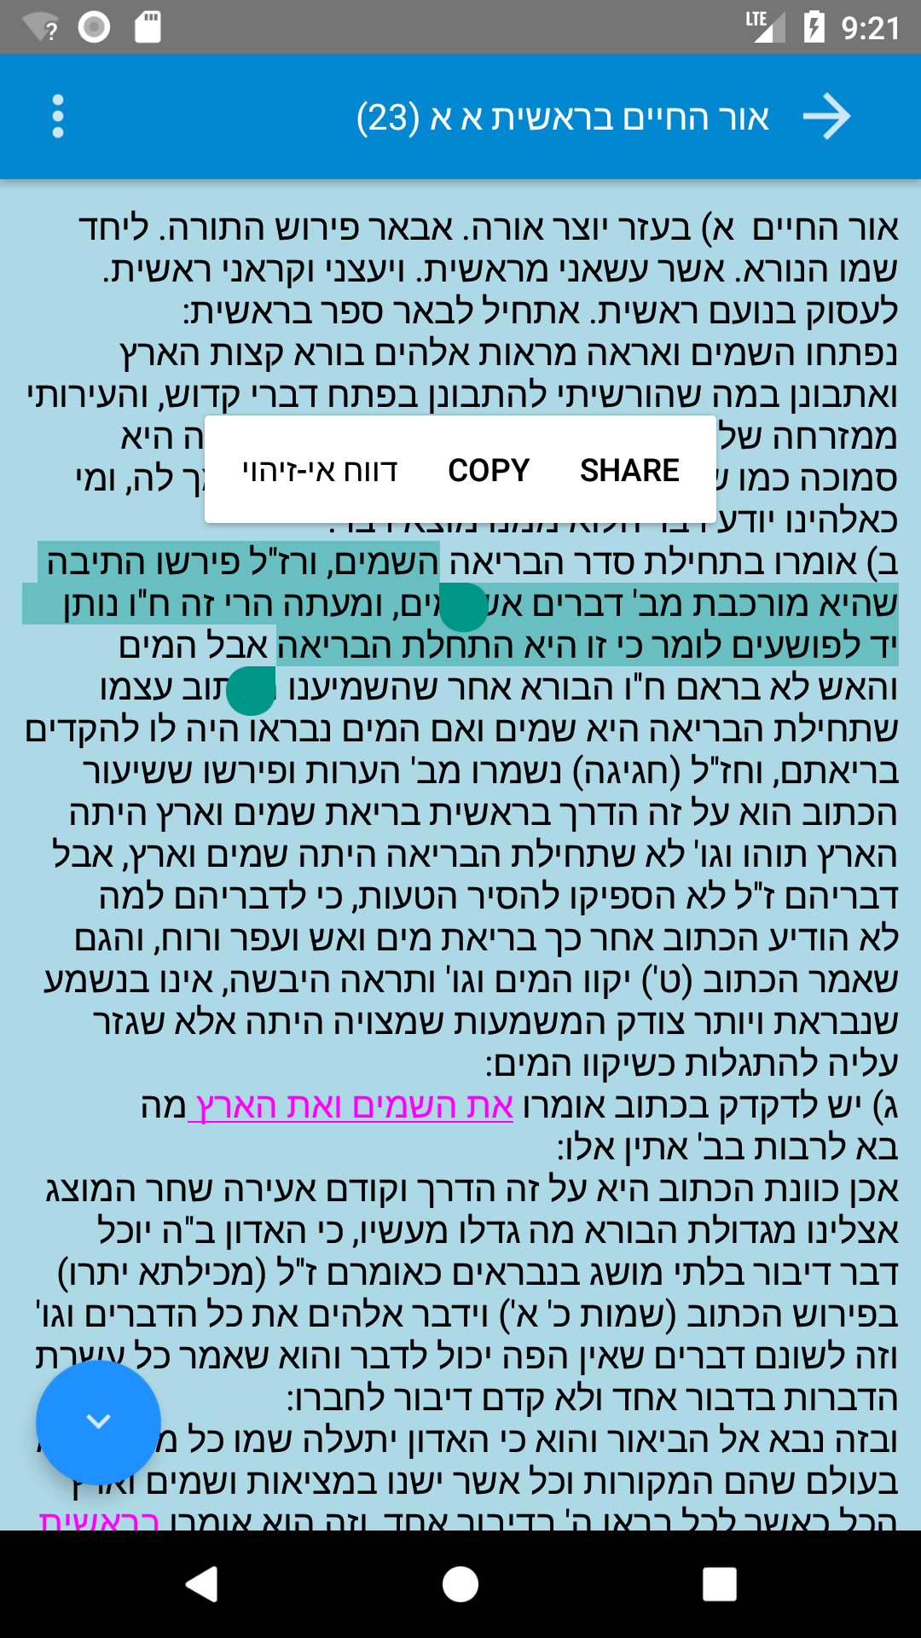
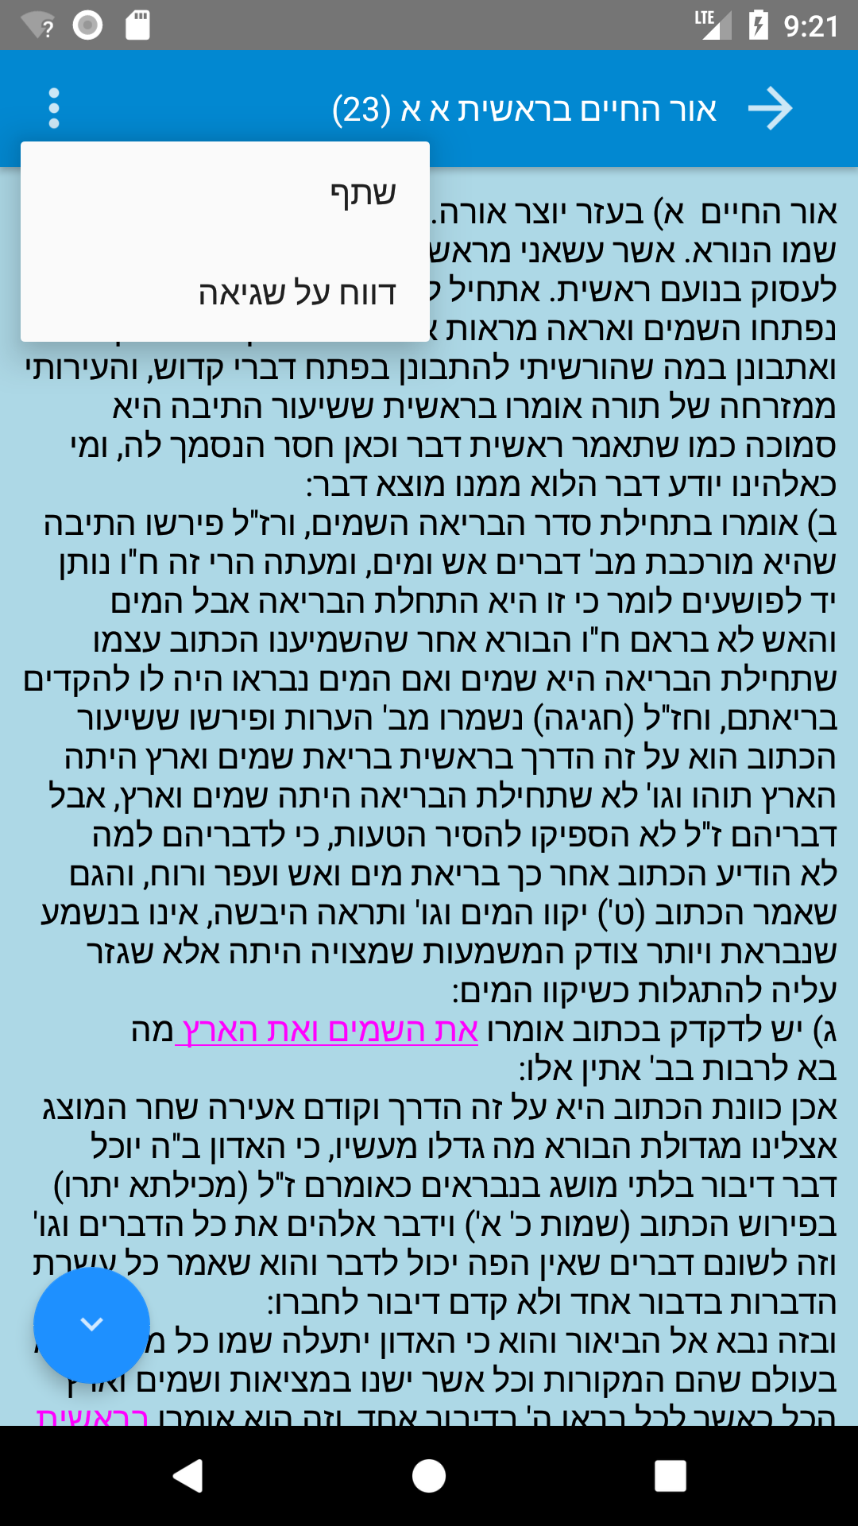
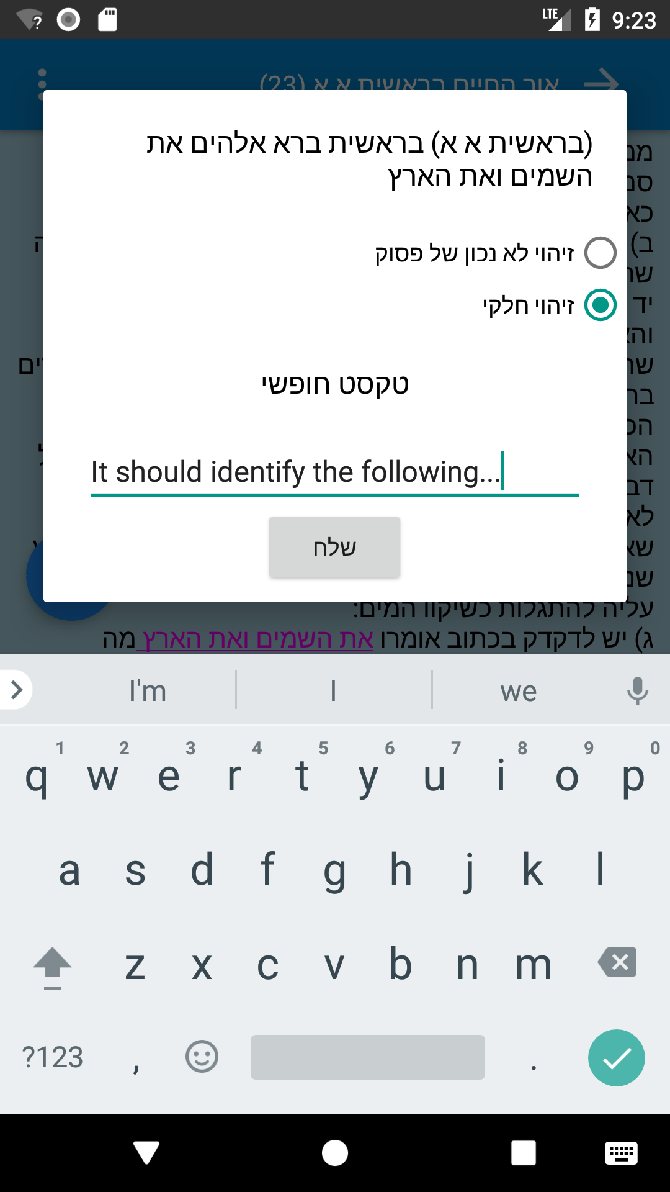
Error Reporting Options
Clicking an highlighted text
Manual text selection
Report through the menu

Slide 8
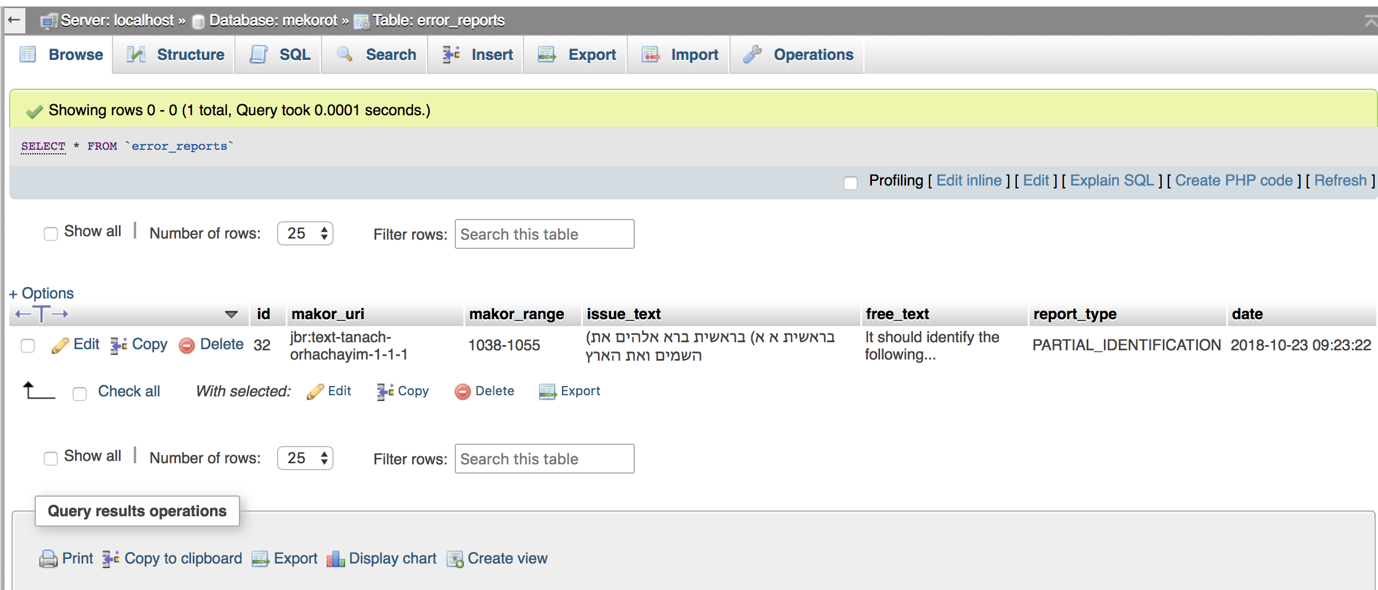
Error Reporting
The detailed error report is saved in an SQL DB on a remote server, allowing the app admin to review all the error reports and perform SQL queries on them

Slide 9
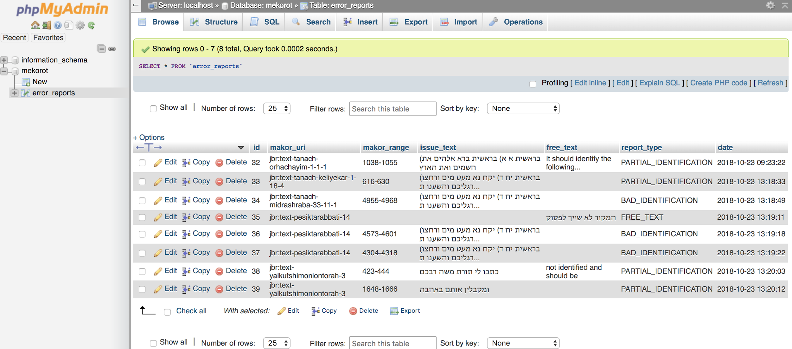
Error Reporting - Example Queries
Select the database and table

Slide 10
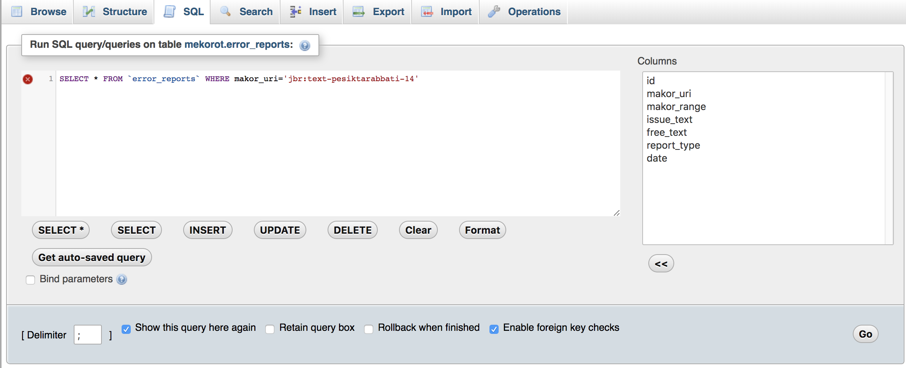
Select SQL tab
Type an SQL query. This query gets all the errors reported for a specific Makor
Click “Go” to run

Slide 11
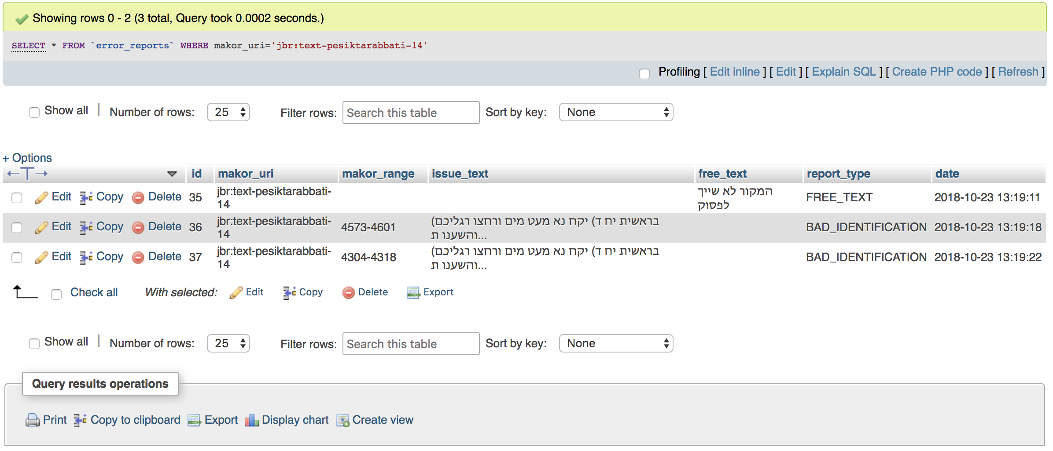
Review results

Slide 12
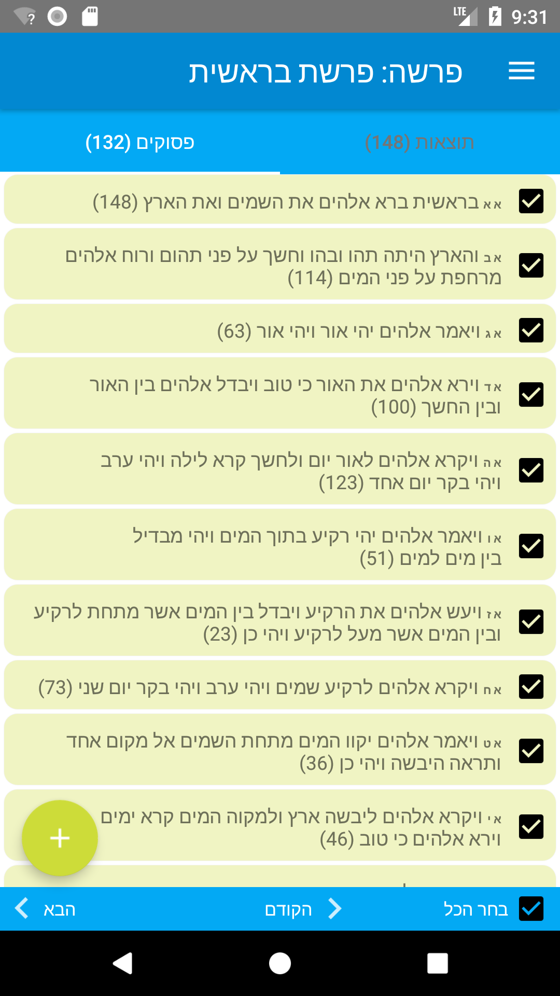
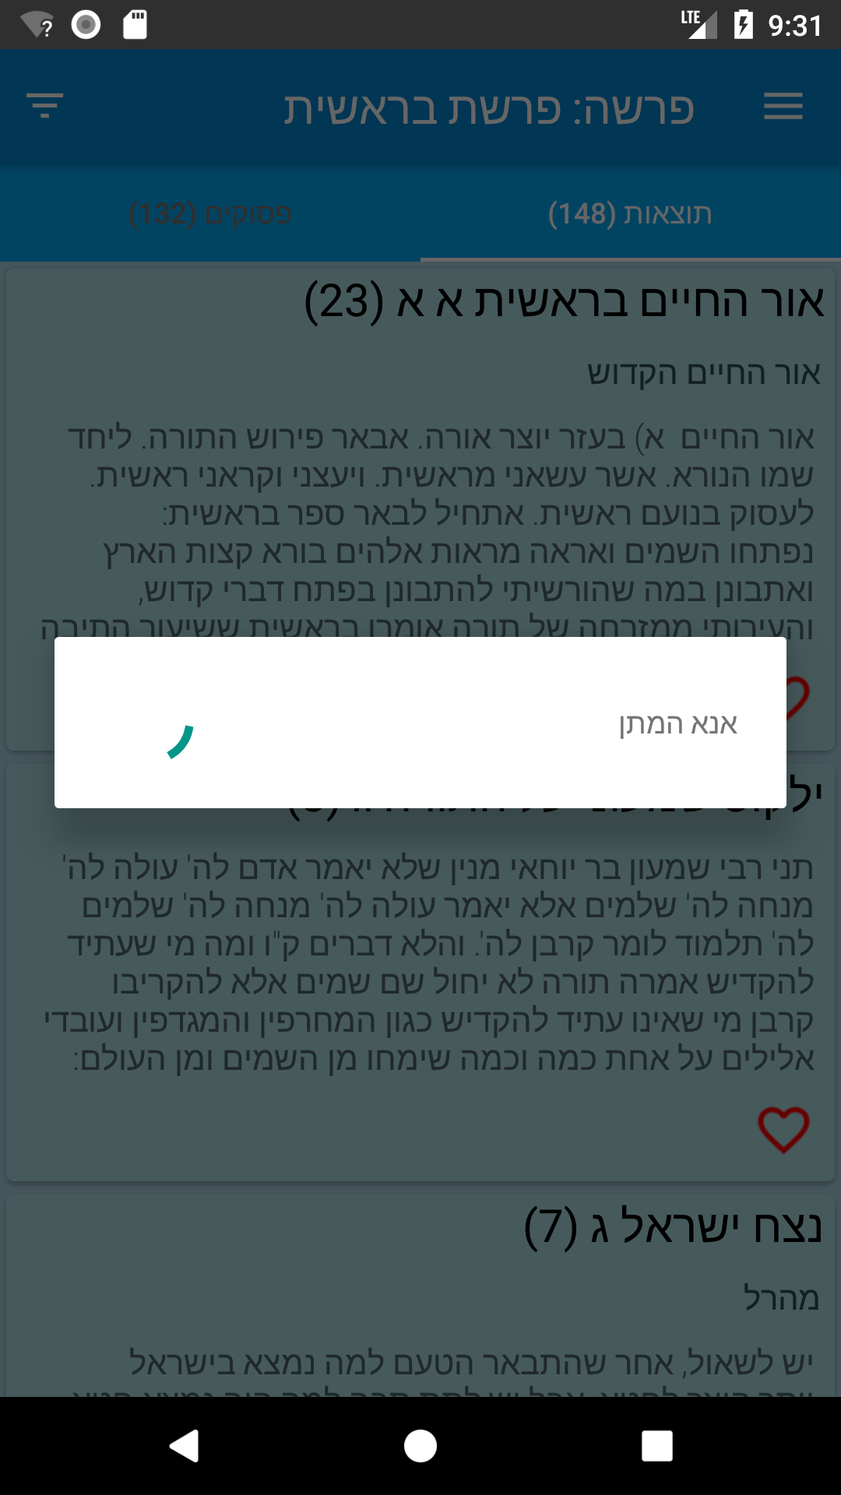
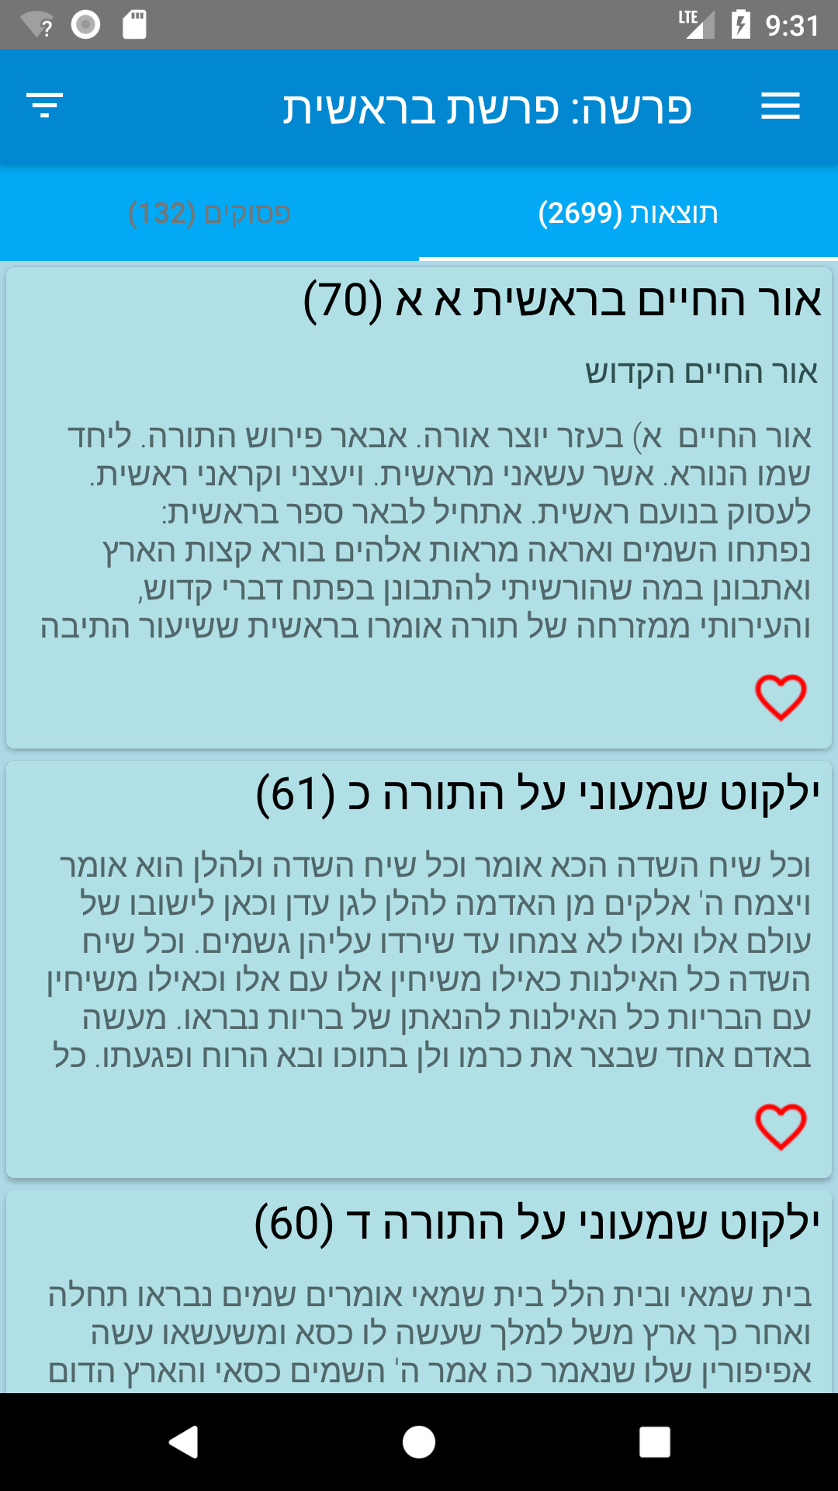
Results Caching - Overview
Heavy queries can take long time to run. Querying the results for a whole Parasha for example is a heavy query with around 2700 results can take up to 20 seconds.

Slide 13
Results Caching - Overview
Caching the results locally allows the user to request the results later and receive them instantly, skipping the asynchronous query to a remote DB.

Slide 14

Results Caching
Architecture
An instance of Cacheable contains the results data and exposes an interface that allows fetching and reading the data
Allows reading and writing serializable data to the device internal storage
Cacheable
InternalStorage
DataManager
PsukimForParasha
SPARQL
Query
User
RDF
MekorotForPsukim
Abstracts the application data source (Storage or Remote)
DataManager decides from where to read the data. If it’s cached - read it from InternalStorage.
If not cached - fetch from RDF
Sulamot App
SharedPreferences
Checks if the current query results are cached

Slide 15
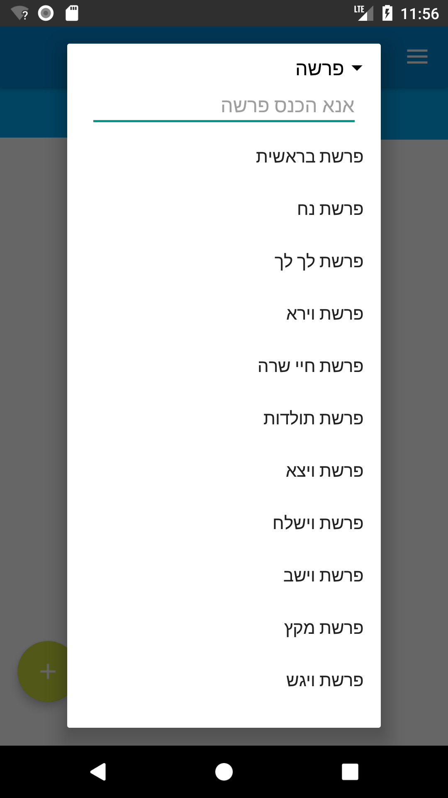
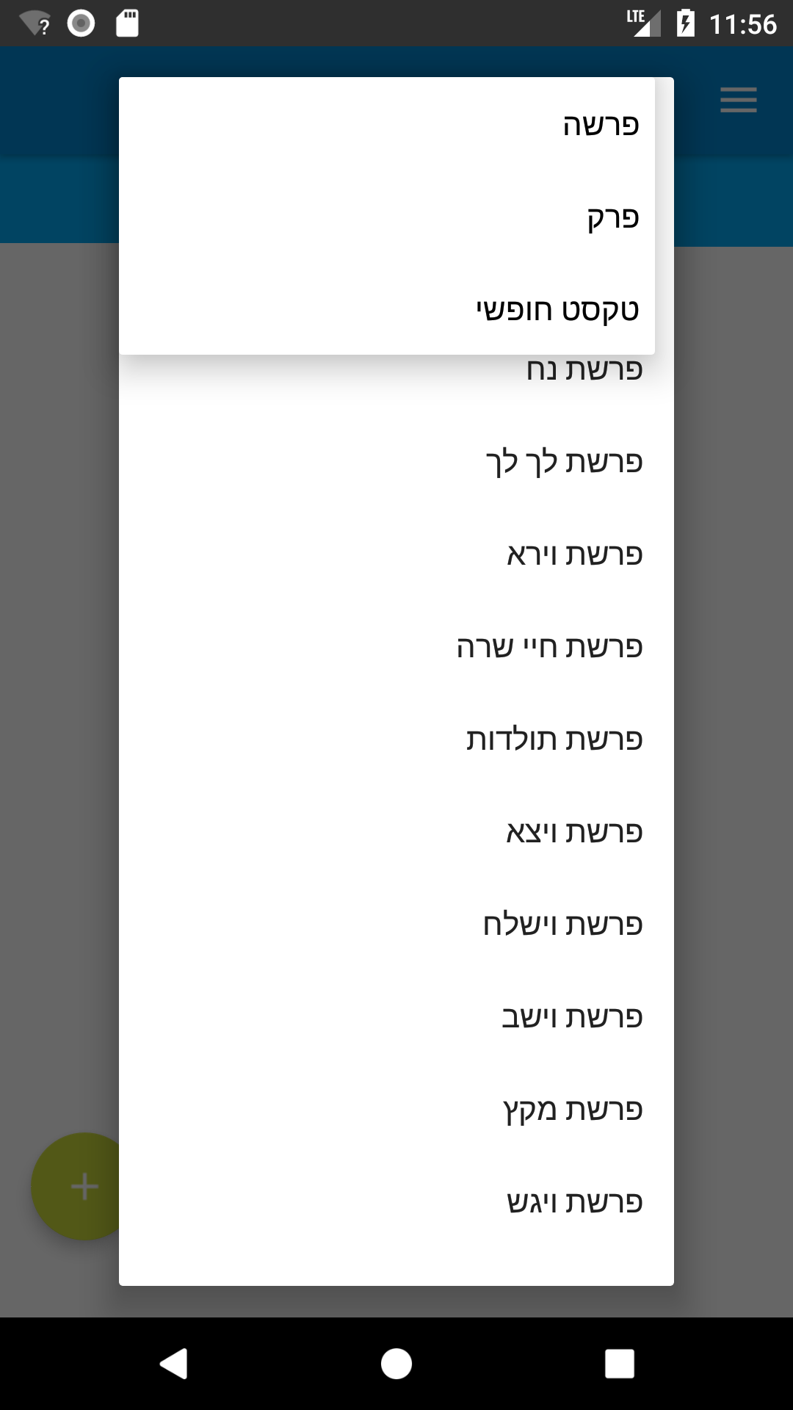
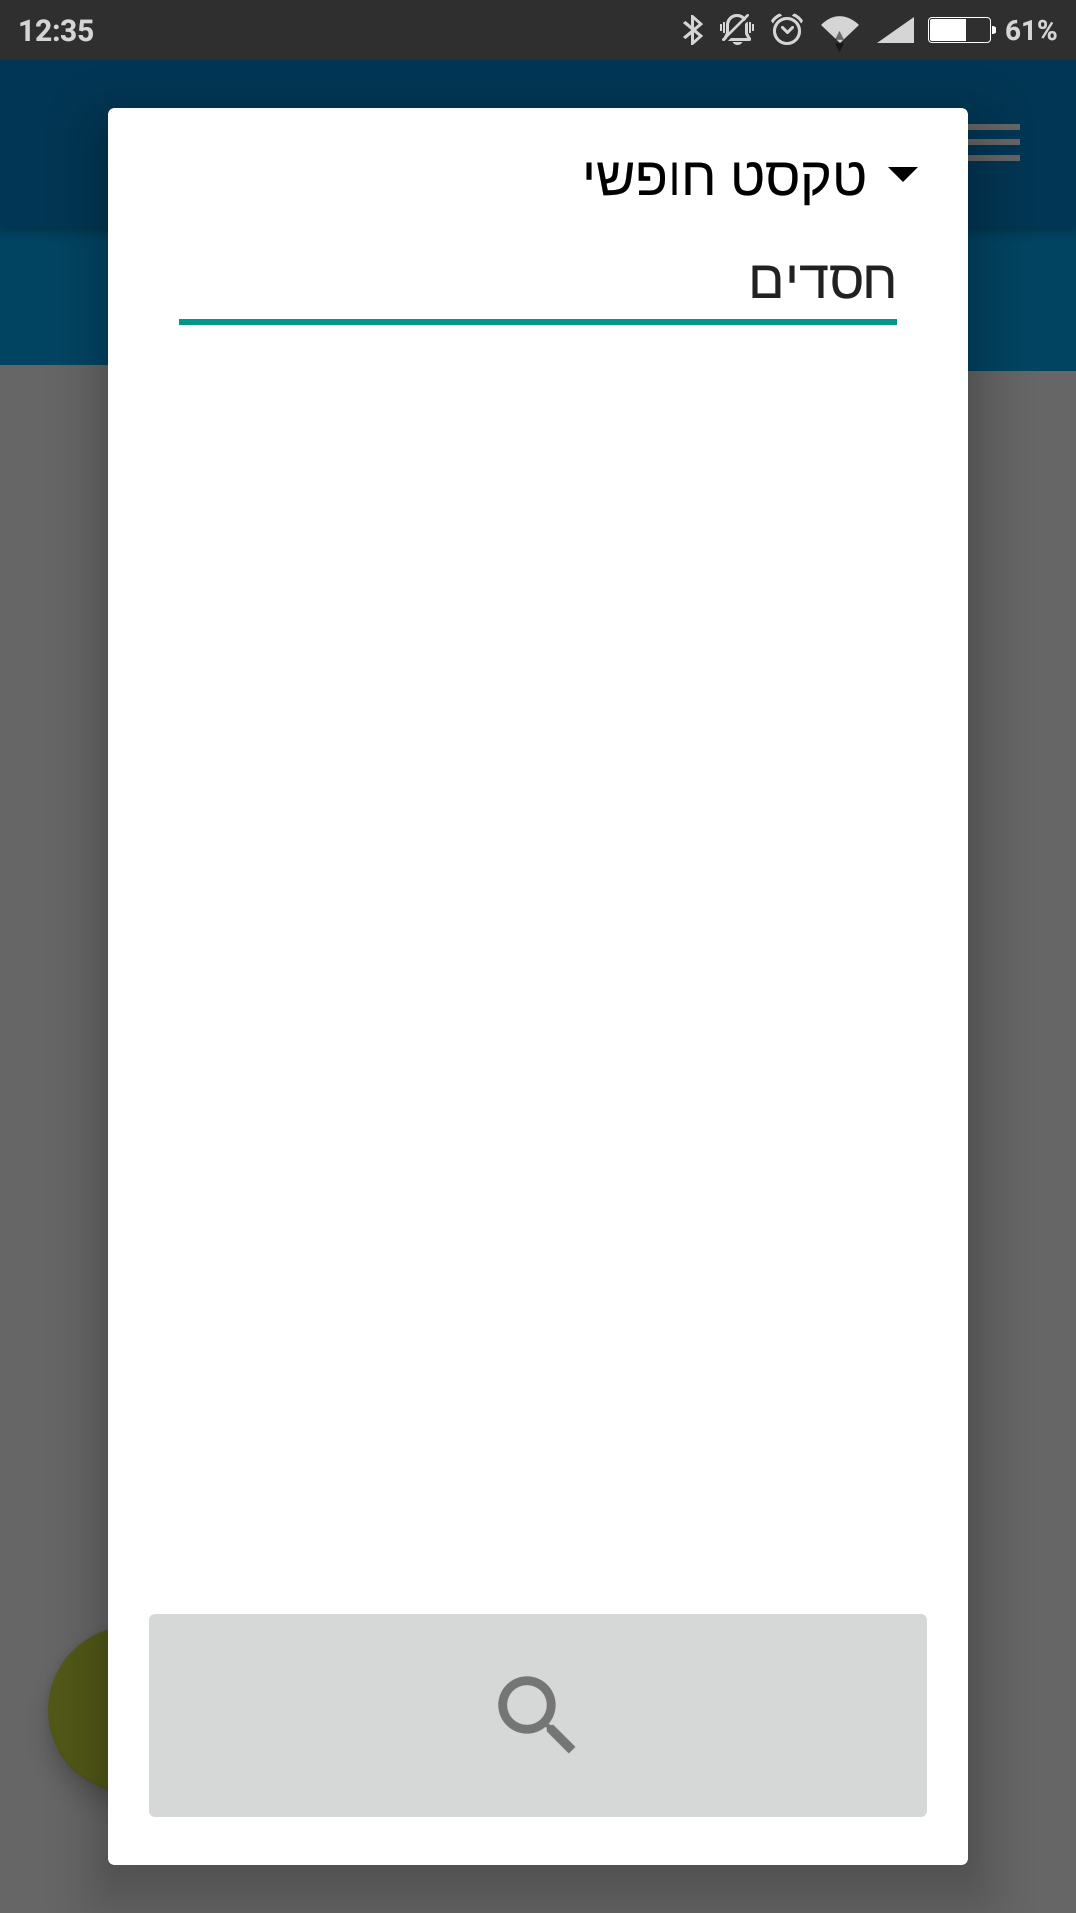
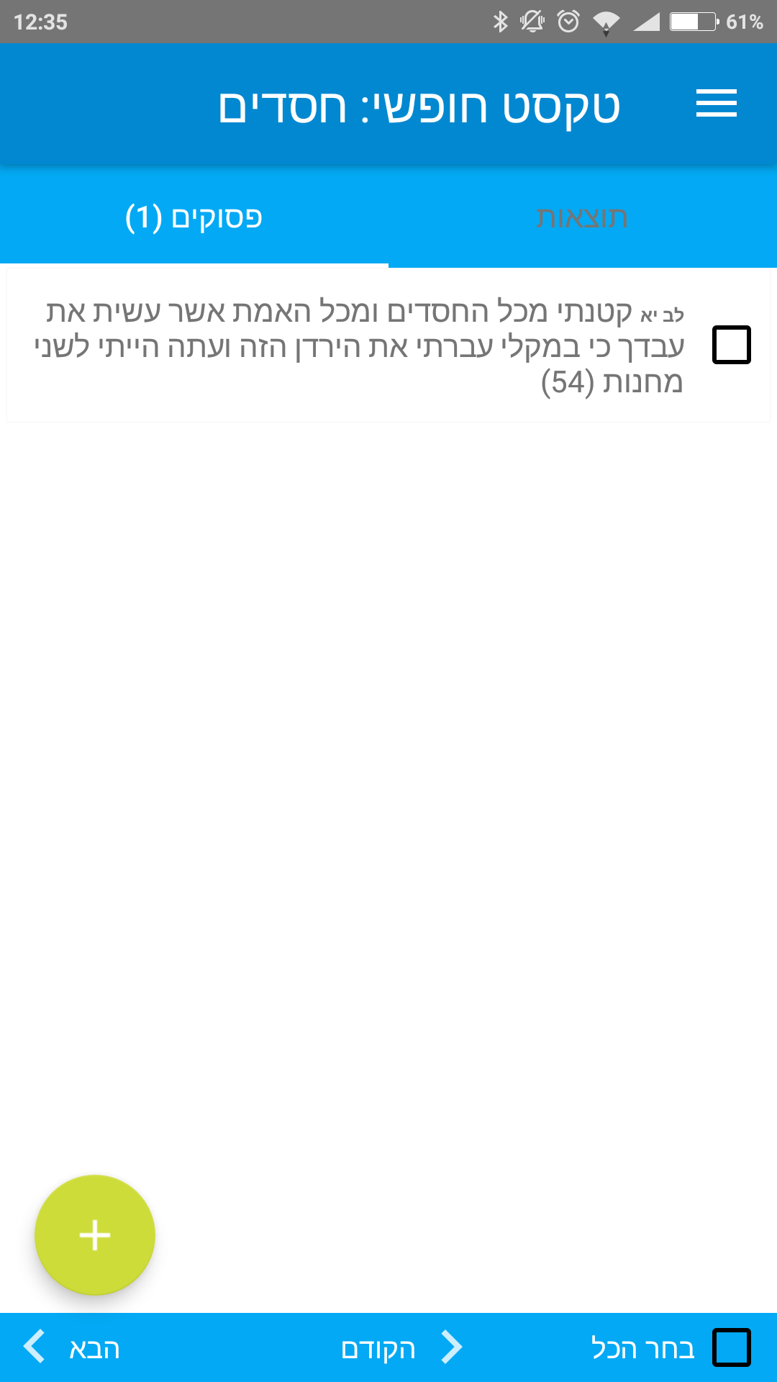
Extended Search Mode
Added a search mode that allows the user to find all the Psukim which contain a given substring

Slide 16
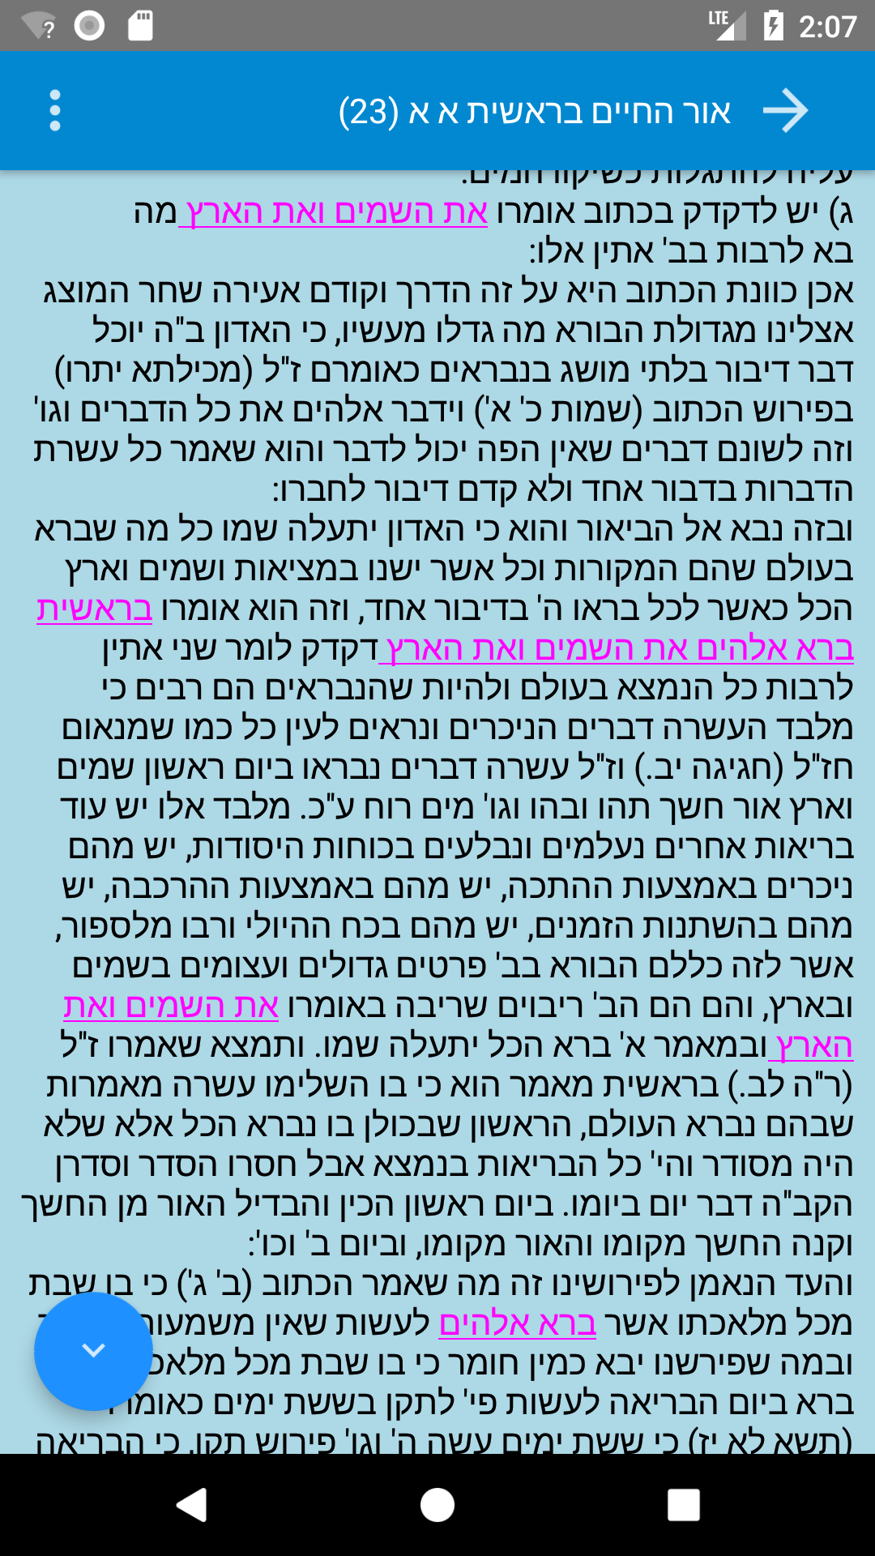
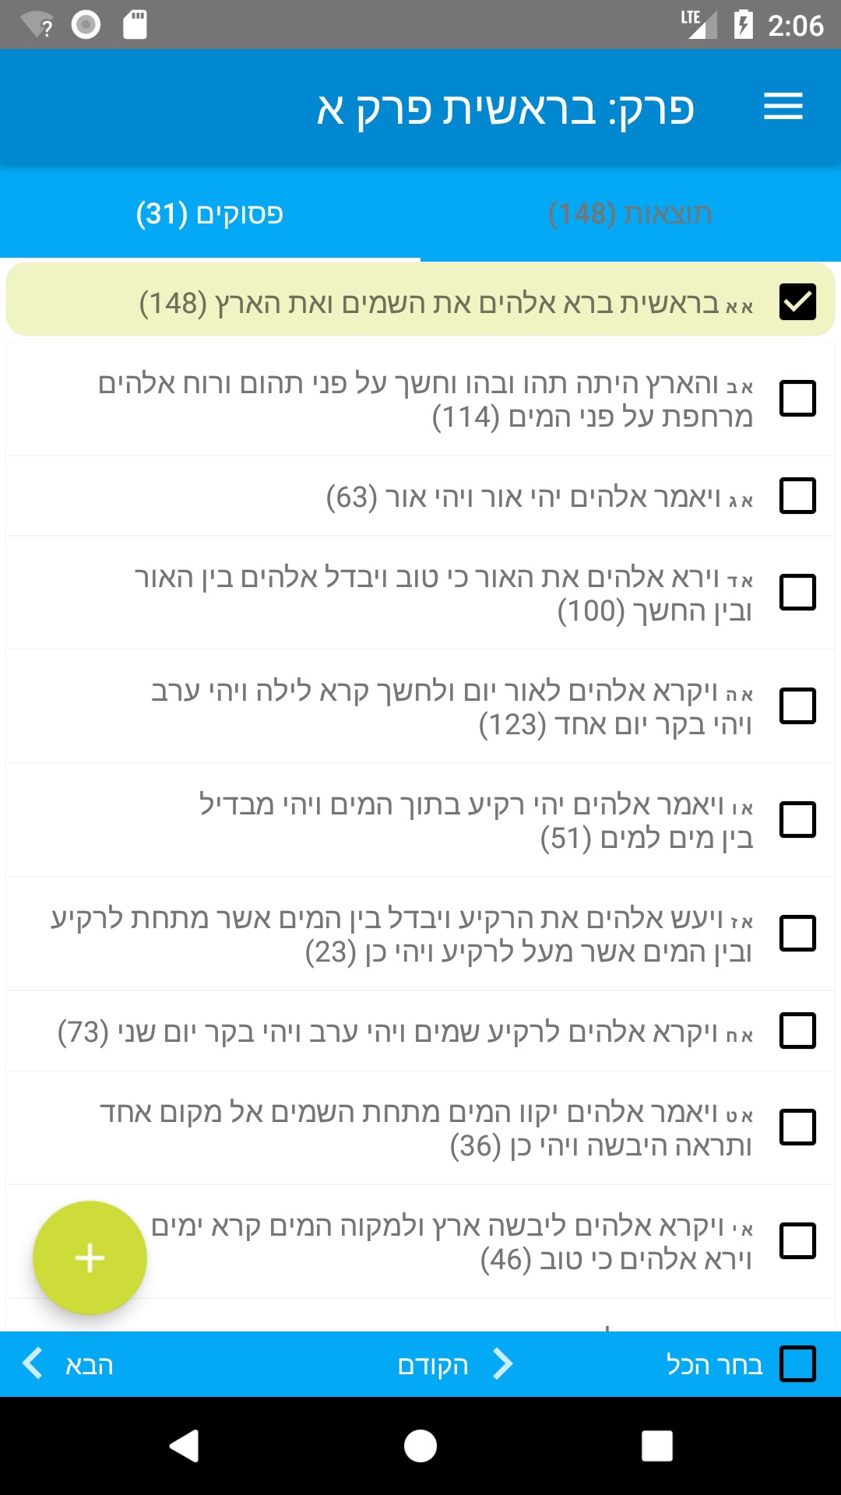
Structural Modifications - UI Improvements
A navigation fab has been added to the result activity, allowing the user to navigate between the highlighted substrings
A bottom UI has been added to the main activity, allowing the user to browse between Parashot/Prakim without having to open the search menu at all.
The application theme has been changed to a more user-friendly and correctly contrasted colours.

Slide 17
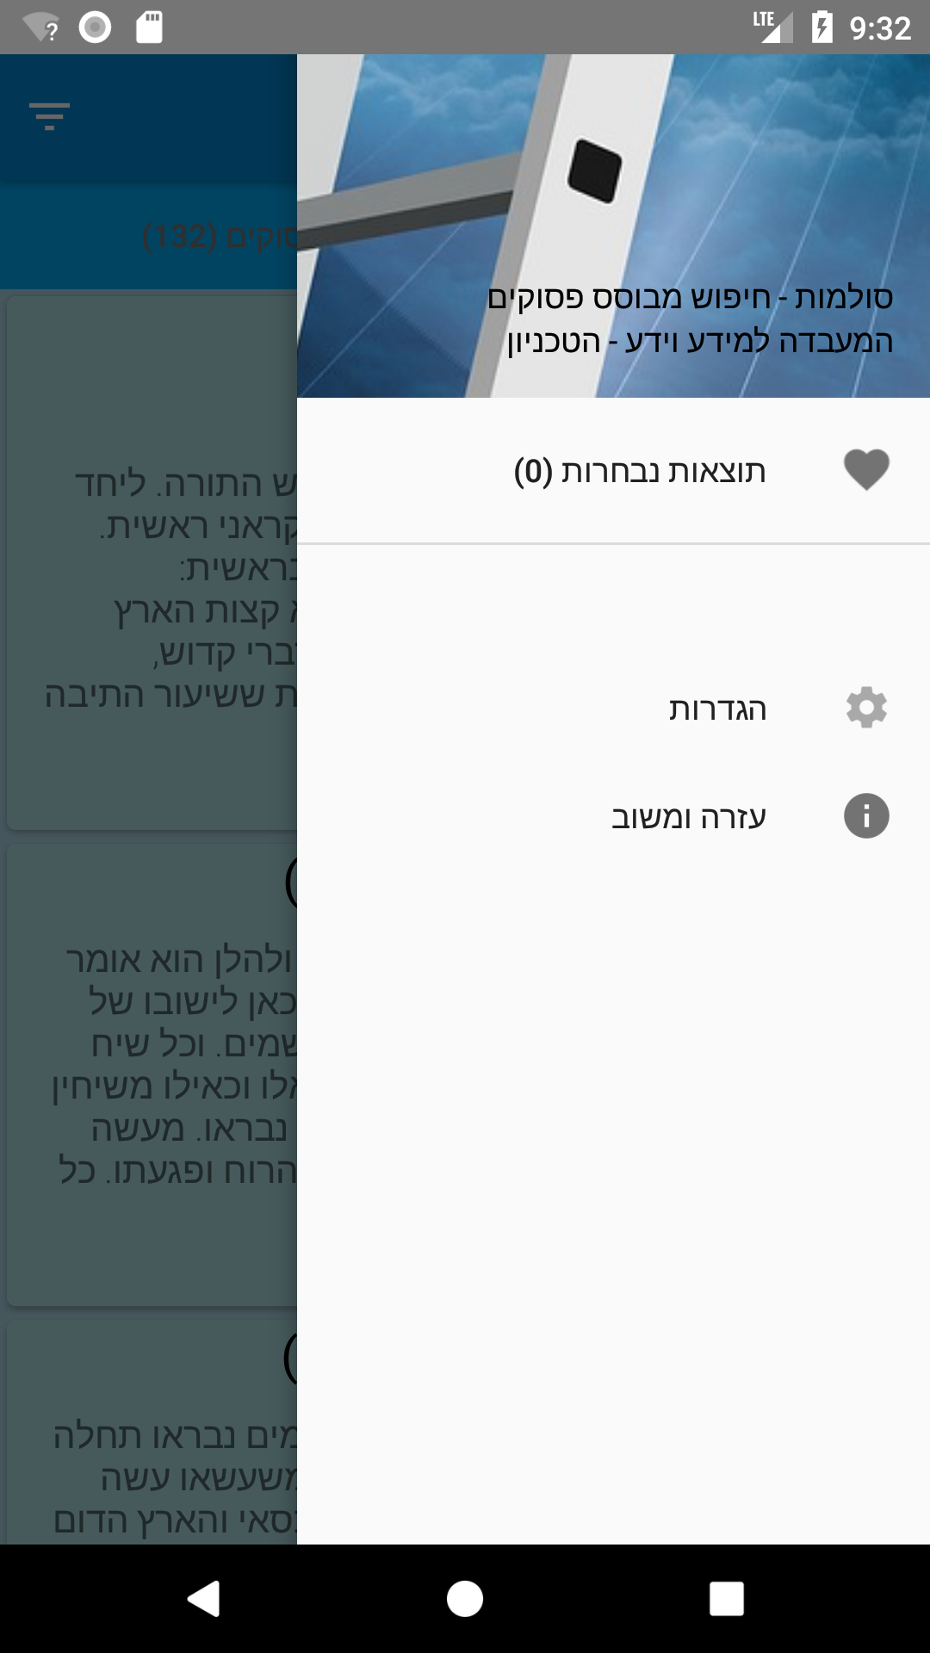
Structural Modifications
Added a Navigation Bar that can be opened by sliding from the side edge of the screen, or by the menu button in the app toolbar.
The Navigation Bar centralizes all the application utilities into one place, in a more user-friendly way.
As a derivative of the above, the “Favorites” page who used to be a fragment in the main ViewPager was separated into a standalone activity, loaded from the Navigation Bar.

Slide 18
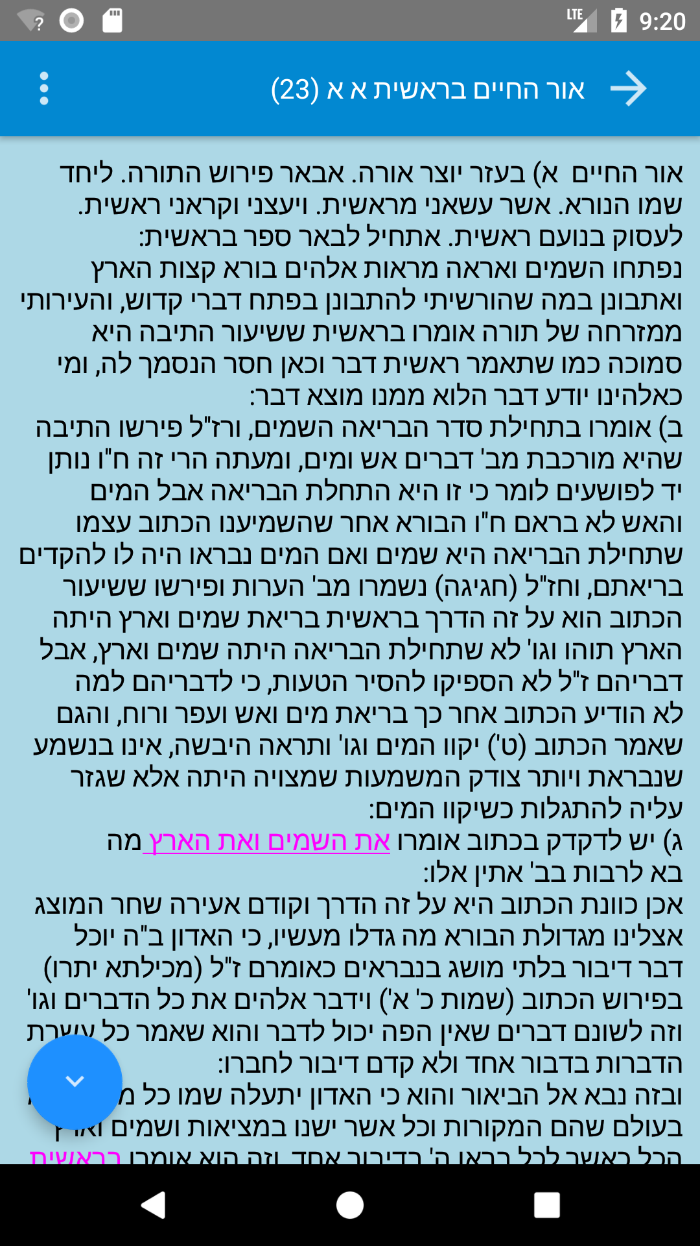
Structural Modifications
Previous structure had loaded a new activity to show a single result data.
At the new structure, a ViewPager was added to the activity, loading all the results into the ViewPager underlying data container, and allowing the user to browse between the results without having to go back to the main results screen.
Swipe

Slide 19
Challenges
Navigating inside an existing project can be harder than writing a new project from scratch
Configuring the Android Studio to the correct settings to be able to build the existing project, and upgrading the project settings which were obsolete and required some gradle and code modifications that were hard to find
Part of the tasks needed modifying of SPARQL queries and writing new queries. I had no earlier experience in working with SPARQL and RDF and had to learn and improvise on-the-fly mainly by examining the existing queries and their results, and using some online references
Structural changes such as adding the Navigation Bar to the main activity created constraints that needed precise code modifications such as changing a callback endpoint and interface, and thoroughly debugging the code flow in order to understand what parameters needs to come from where

